Slide 1
hardware Texturing
3DCC day6

Slide 2
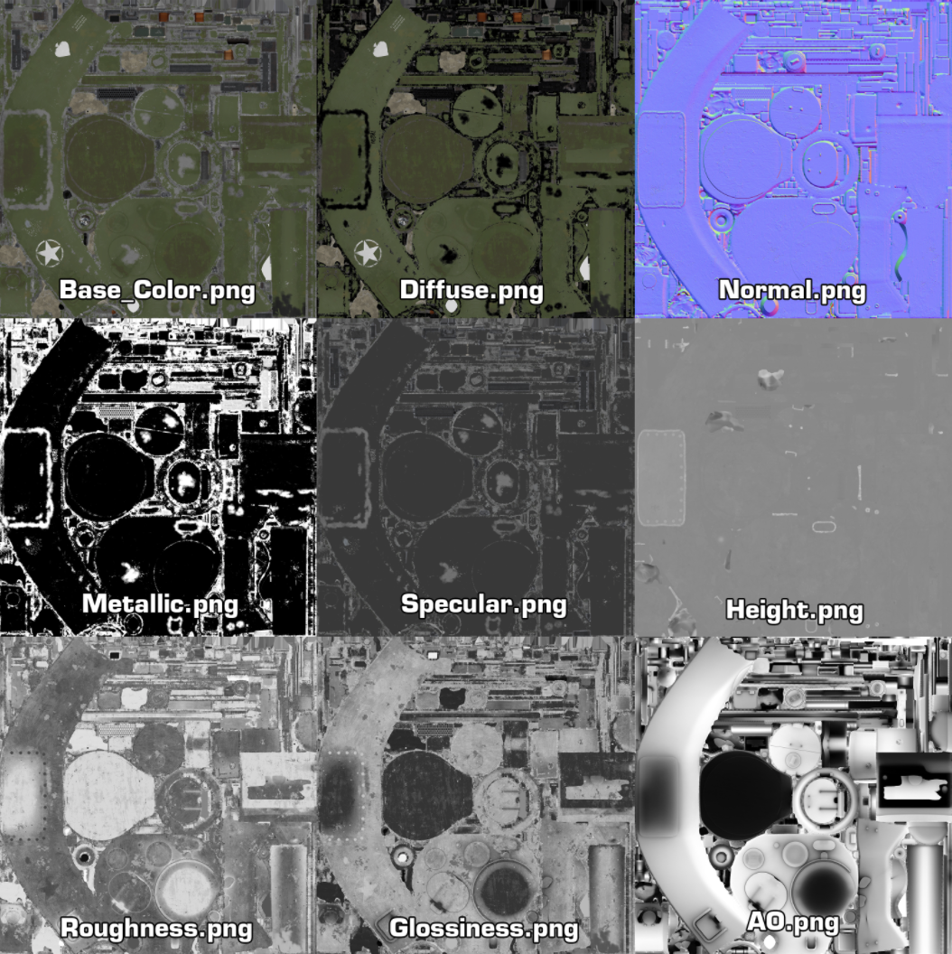
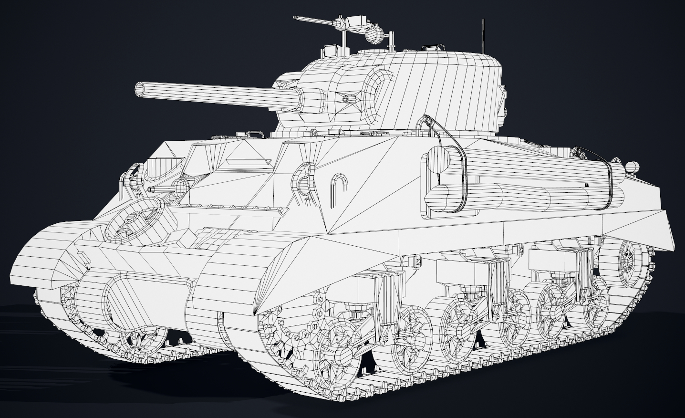
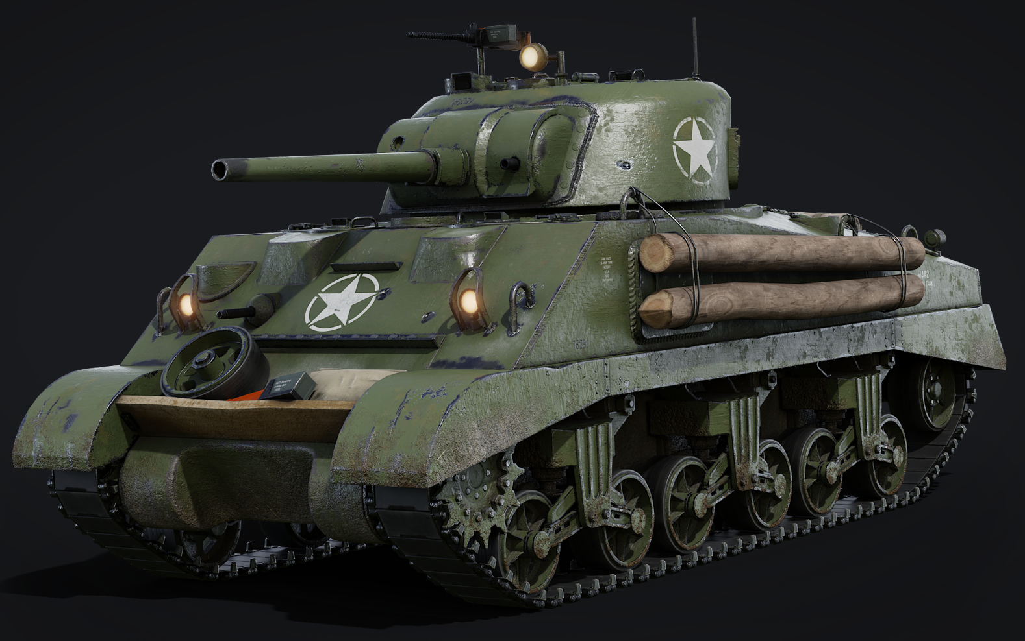
Textures ARE CORE TO 3D RENDERING

Slide 3
BEYOND MODELS: USES FOR HARDWARE TEXTURES
On Screen Render Targets
The Swap-chain/Back-buffer
Off Screen Render Targets
Render To Texture/Post-processing
Z/Depth Buffers
Lights can have them too (Shadow Maps)
Volume/3D Textures
Voxel Data, 3D Scans, Fluid Simulation
Cube Maps (6 sided textures)
Skyboxes & Environments Reflections
Light Maps
Pre-calculated lighting stored in textures
Stencil Buffers
Portals and Mirrors, Stencil Shadows
Height/Displacement Maps
For Terrain and other Tessellated surfaces

Slide 4
TEXTURE FILE FORMATS FOR GPU HARDWARE
Khronos Texture (*.KTX/*.ktx2)
Direct Draw Surface (*.DDS)
Designed for OpenGL and Vulkan
Supports Mipmaps
Supports Cube maps
Supports Hardware Compression
Supports HDR
Designed for Direct3D(All)
Supports Mipmaps
Supports Cube maps
Supports Hardware Compression
Supports HDR

Slide 5
image conversion & enhancement TOOLS
NVidia Texture Tools Exporter (KTX+DDS)
AMD’s Compressonator (KTX+DDS)
PowerVR Texture Tool (KTX+DDS)
AMD Cube Map Generator (legacy)
GIMP Now has native DDS support
Visual Studio can open and save DDS files

Slide 6
What about OTHER COMMON image formats?
When working with Artists specializing in Game Art it may be possible to request textures in .KTX or .DDS, however most 3D art you come across will use a variety of non-HW-specialized image formats like PNG, TGA, JPG etc.…
In this scenario you could load the raw uncompressed image data and generate your own mipmaps, but this approach slows load times and is space inefficient.
A more effective solution is to pre-process this data into KTX and/or DDS formats before using it in the renderer.
Its possible to do this by hand for now, but most studios have build-tools that traverse their raw game assets and convert them to more specialized game-ready formats.

Slide 7
Texture sampling hardware
In addition to shape drawing & interpolation, GPUs also are designed to accelerate reading texture data and the filtering of that data.
Sampling textures typically takes place in the pixel/fragment shader, though textures can be accessed in other shader stages on modern hardware.
The following services are provided by the texturing hardware:
Mip-Mapping (if mipchain is present), Filtering, Texel Comparisons, UV Addressing.
A sampler is an API object designed to configure hardware texturing options.

Slide 8
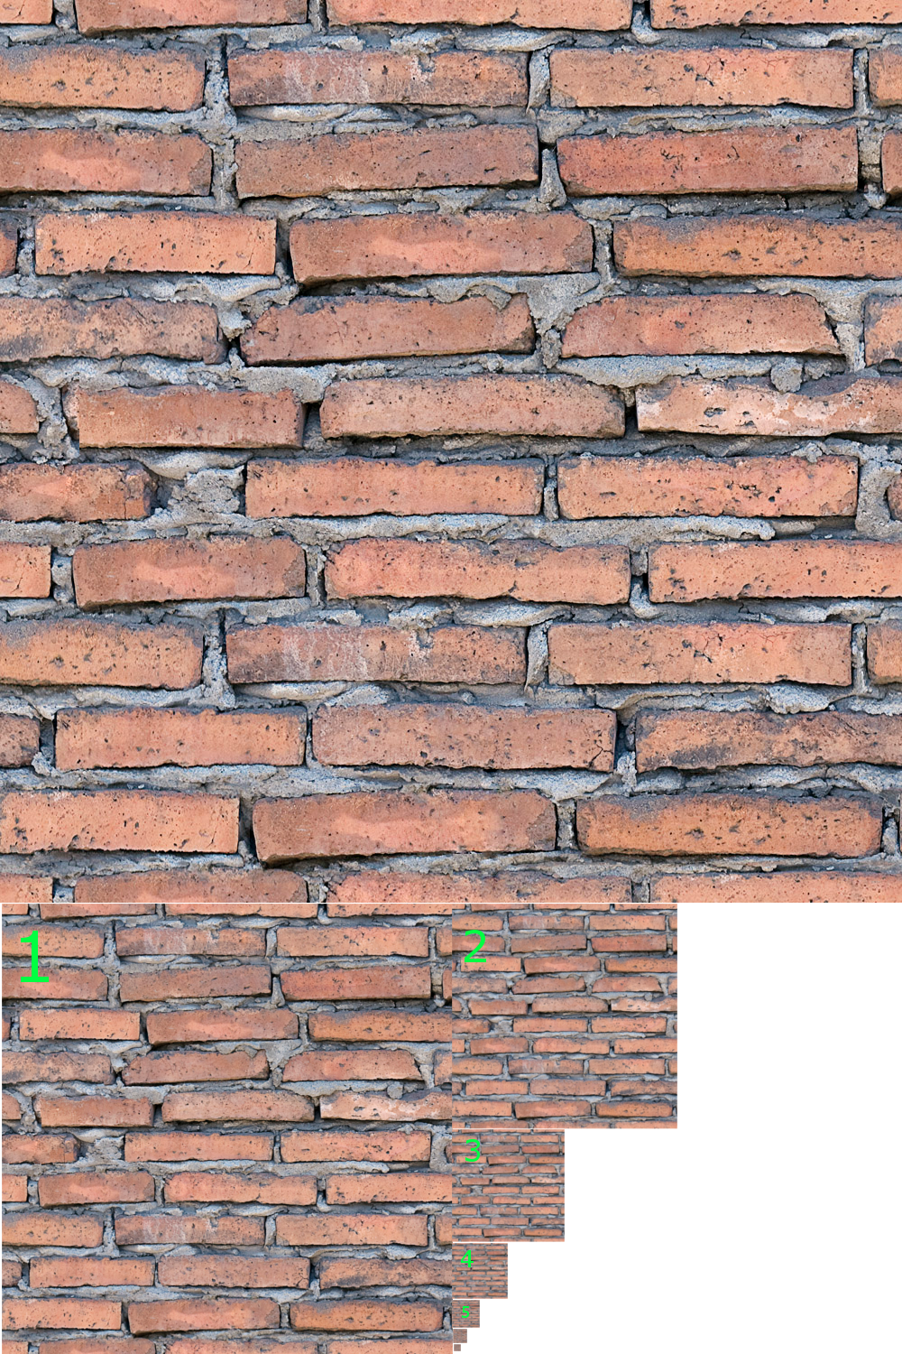
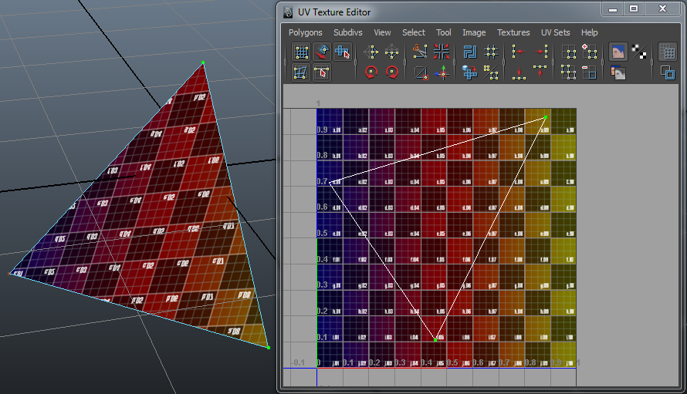
SAMPLERS: AUTOMATIC DU/DV MIP-MAPPING
ΔXY
ΔUV * WH
ΔXY
ΔUV * WH
ΔUV * WH
ΔXY

Slide 9
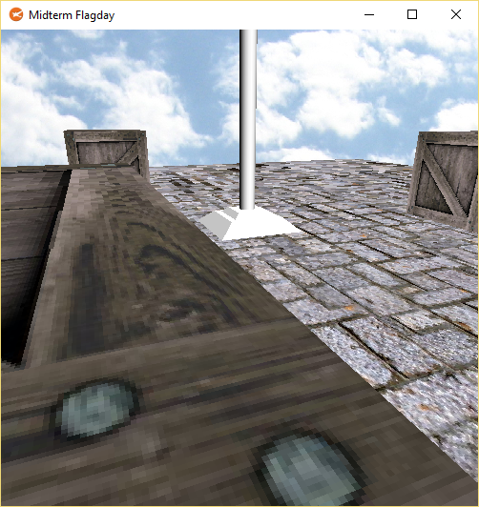
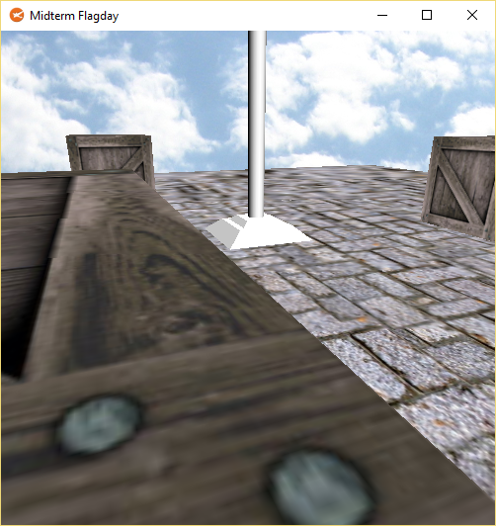

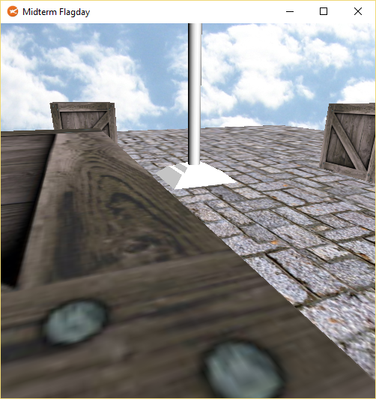
SAMPLERS: SELECTABLE FILTERING/QUALITY
NEAREST
BILINEAR
TRILINEAR
ANISOTROPIC

Slide 10

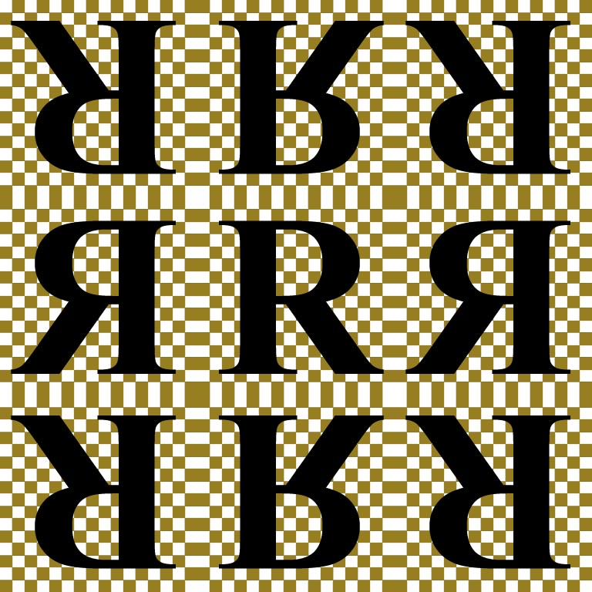



SAMPLERS: SELECTABLE ADDRESSING MODES
(0,0)
(1,0)
(0,1)
(1,1)
WRAP
MIRROR
OPENGL DEFAULT MODE
D3D11 DEFAULT MODE
CLAMP
BORDER

Slide 11
API SPECIFIC TEXTURE LOADING Libraries
Khronos Texture Software (KTX, Vulkan + OpenGL)
OpenGL Image {GLI} (KTX DDS, OpenGL + Vulkan)
DirectX Tool Kit for DirectX11 {DDSTextureLoader.h} (DDS, Direct3D11)
DirectX Tool Kit for DirectX12 {DDSTextureLoader.h} (DDS, Direct3D12)
stb_image (JPG PNG TGA BMP PSD GIF HDR PIC, raw RGBA colors)

Slide 12
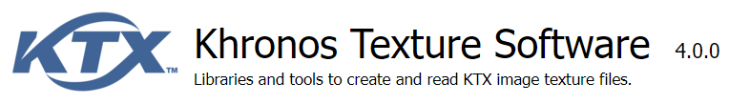
TEXTURING DEMO: KTX & DDS TEXTURE libraries

Slide 13
ADVANCED TEXTURING: BINDLESS TEXTURES
Allows developers to stop switching textures between draw calls!
This can allow for massive performance improvements & simplified code.
This is only available on recent GPUs, and you must query the API for it.
Example in Direct3D12
Example in Vulkan – Example in GLSL
While bindless is common for texturing, it can be used on any resource!
Nice overview/discussion here.

Slide 14
Programming presentation
Texturing Stonehenge

Slide 15
Q

